Slide 1

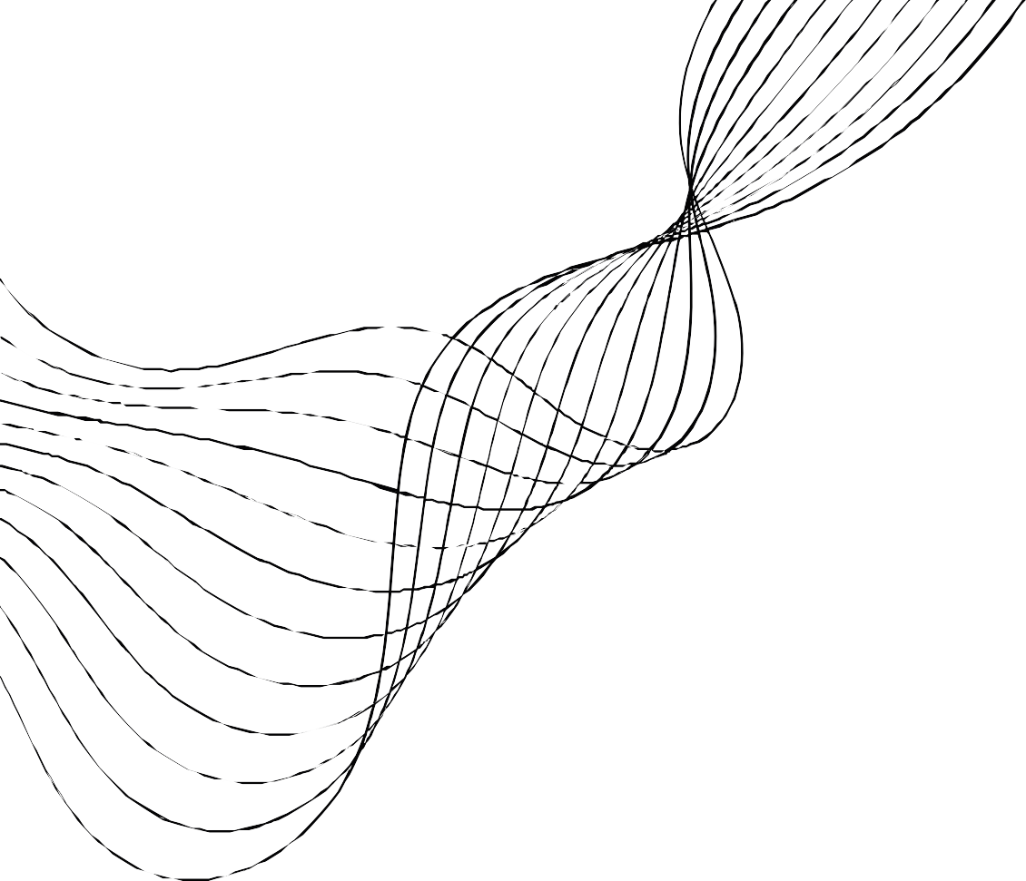

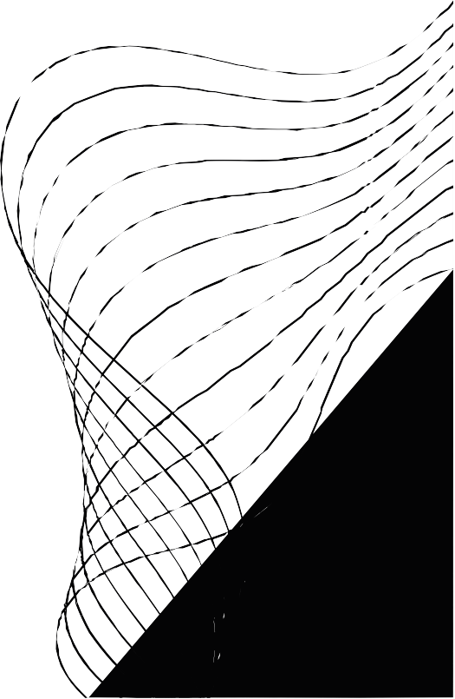
AI PROJECT
SUBMITTED TO : DR NAVPREET

Slide 2


IMAGE FILTERING AND PROCESSING

Slide 3
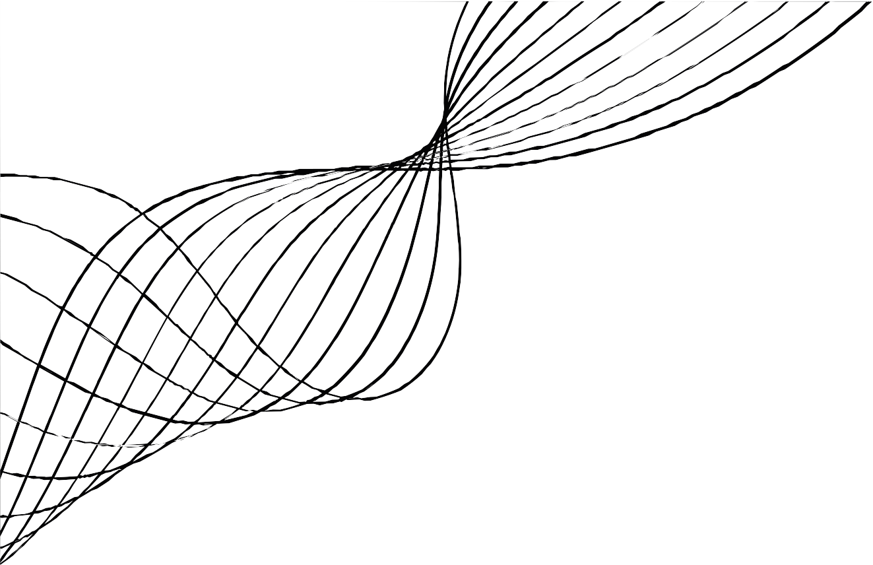
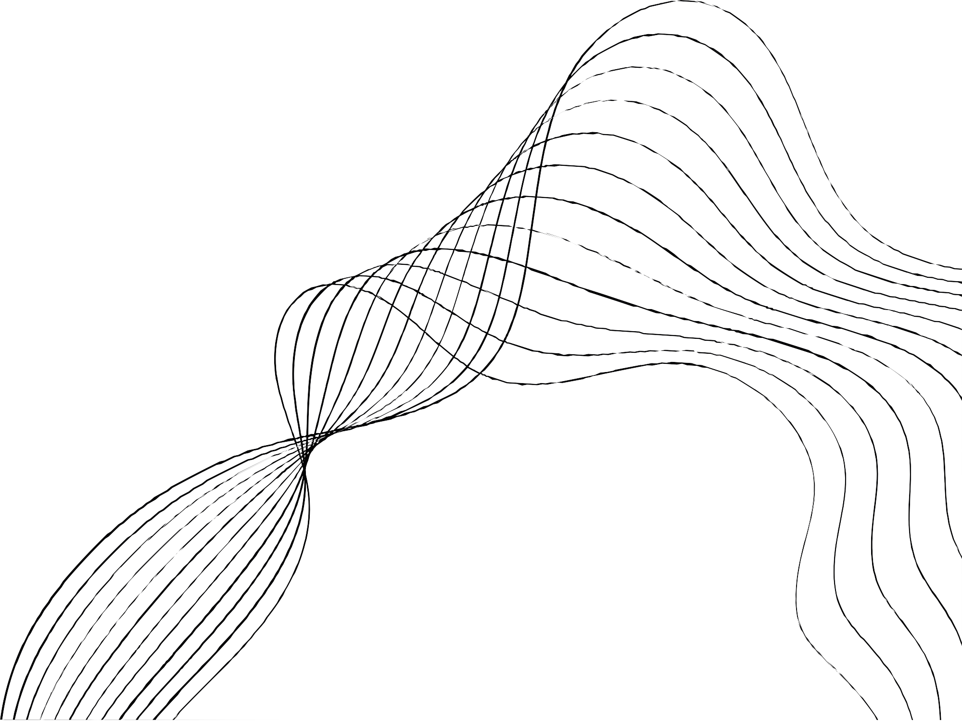

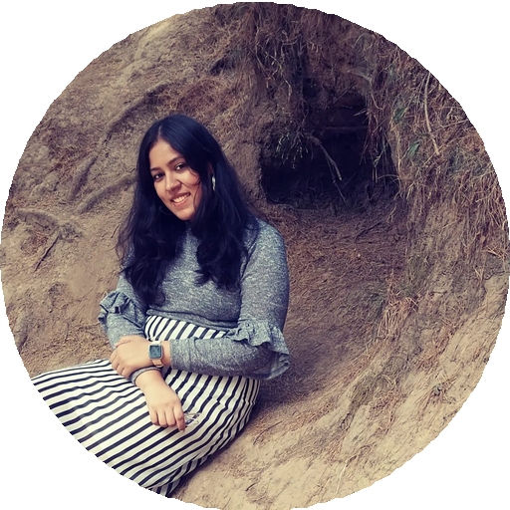
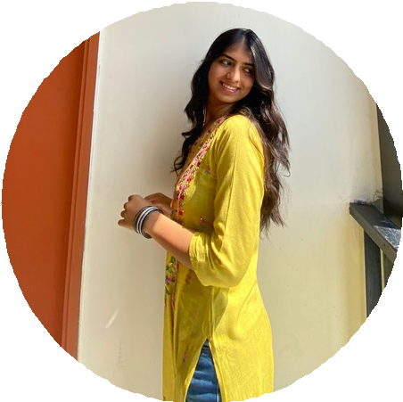


OUR TEAM
Varshitha Pentu
102103107
Lavisha Lakhmani
102103109
Shaina
102103118
Jaskiran Walia
102283023
102
103118

Slide 4
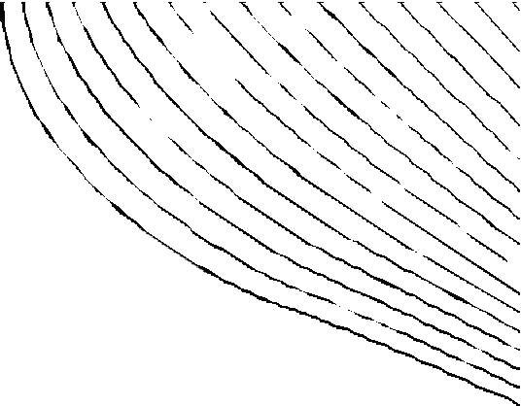
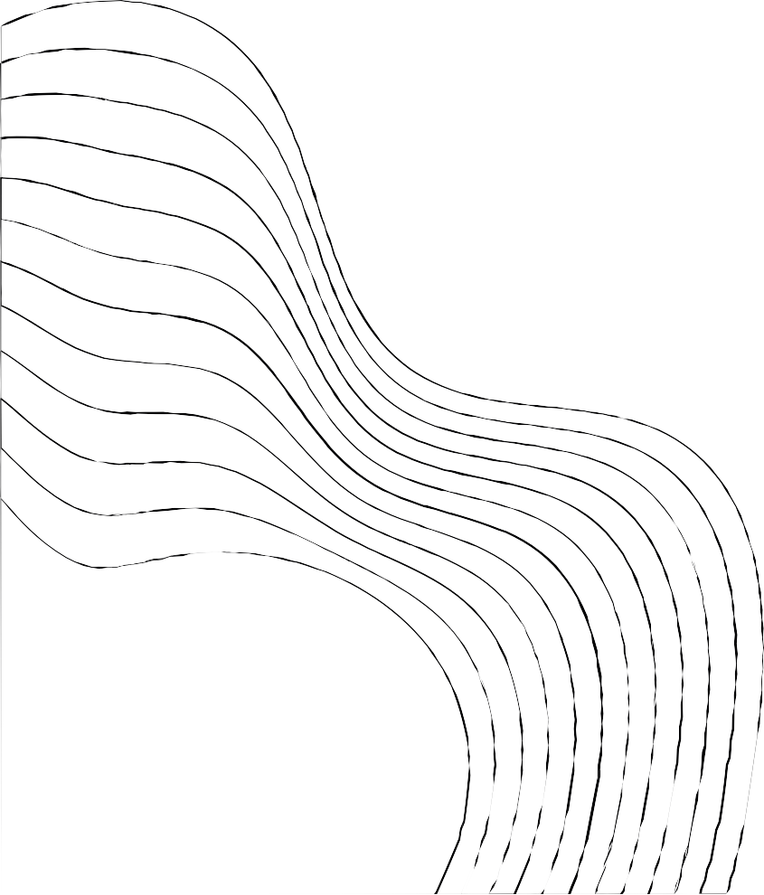
CONTENT
01
02
03
04
05
06
07
08
INTRODUCTION
LITERATURE REVIEW
STRATEGY
METHODOLOGY / ALGORITHM
CODES
RESULTS
APPLICATIONS
FUTURE SCOPE

Slide 5

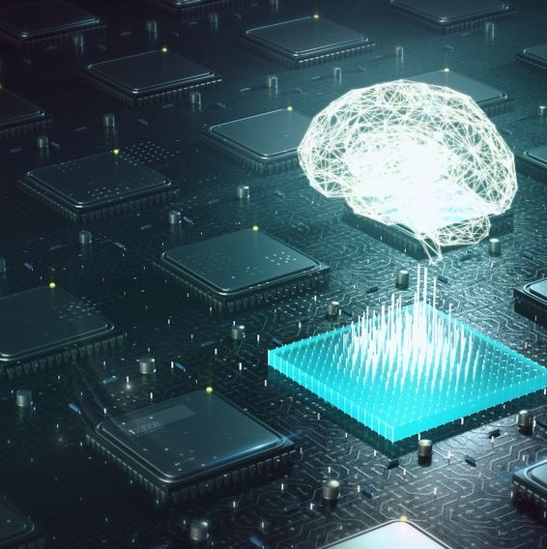

INTRODUCTION
AI image f i l tering is a technology that uses artificial intelligence ( AI) algorithms to automatically f i l ter or analyse photographs. The idea is to train an artificial intelligence system to analyse and edit photos based on predefined criteria such as image quality, image content, and image features.
AI image f i l tering techniques
include
picture image Image
categorization, segmentation,
object
and image
identification, enhancement.
classification entails classifying photographs into distinct groups, such as identifying objects, animals, or landscapes.

Slide 6


LITERATURE REVIEW
Image processing techniques involve all the techniques that are used to enhance graphic appearance of given image or extract specific features from an image for better interpretation by human or automated system. Image processing, especially filtering has become important because there are many factors that affect the quality and purity of the images. For example, the change in pixel density or illumination will negatively affect the images; therefore noise should be removed using filtering. Image filtering is useful for many applications including smoothing, sharping, removing noise and edges enhancement. This project analyses the various algorithms used for image filtering which improves image quality and clarity. The first section introduces different algorithms that are used in image filtering and how each algorithm processes the image. Then, a discussion and analysis of the project has been done to classify and compare between the algorithms studied.

Slide 7




STRATEGIES
Firstly , we installed pip , open cv , numpy , keras and
deepface.
STRATEGY N° 1
We executed some of tthe algorithms through notepad .
Image and code should be in same directory . Then with the help of powershell we
executed the code .
STRATEGY N° 2
Some of the algorithms were executed in python
extension of VS CODE that was launched through
anaconda navigator .
STRATEGY N° 3

Slide 8

ALGORITHMS , CODES AND DEMONSTRATION OF IMAGE FILTERS

Slide 9


ALGORITHM FOR GRAYSCALE
Import the OpenCV library.
Load the image named "shaina.jpg" using the cv2.imread() function and store it in a variable named "img".
Show the original image using the cv2.imshow() function and wait for user input using the cv2.waitKey() function.
Convert the original image to grayscale using the cv2.cvtColor() function and store it in a variable named "gray_img".
Show both the original and grayscale images side by side using the cv2.imshow() function.
Wait for user input using the cv2.waitKey() function.
Close all windows using the cv2.destroyAllWindows() function.

Slide 10


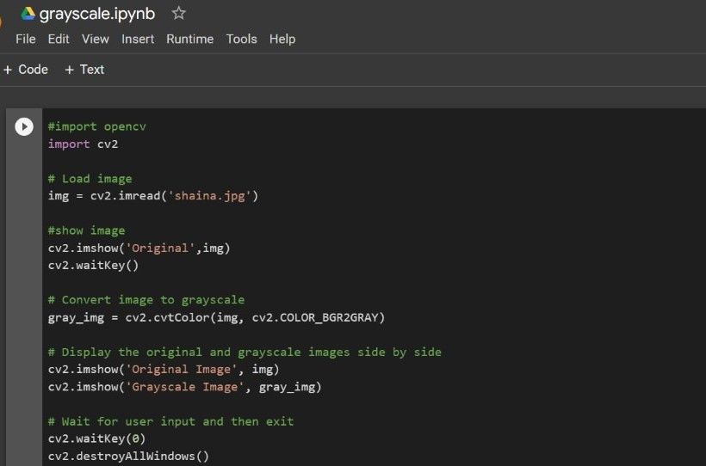
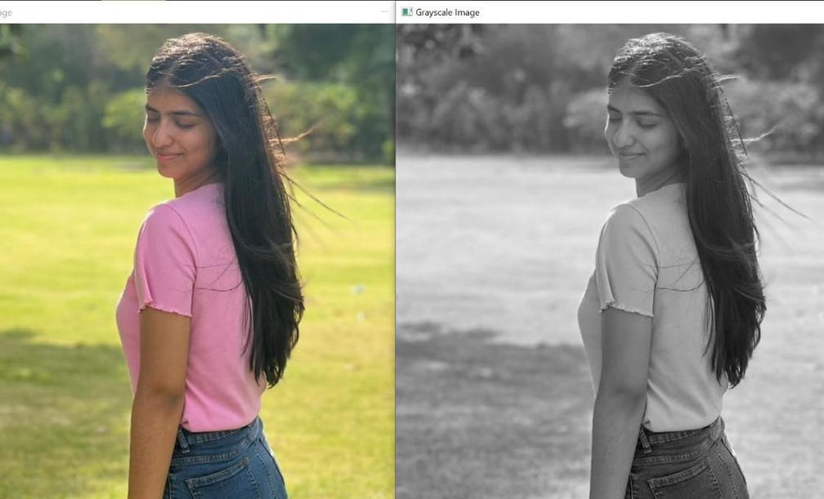
DEMONSTRATION
Computer-generated imagery, a grayscale image is one in which the value of each pixel is a single sample representing only an amount of light; that is, it carries only intensity information. Grayscale images, a kind of black-and-white or gray monochrome, are composed exclusively of shades of gray. The contrast ranges from black at the weakest intensity to white at the strongest.

Slide 11


ALGORITHM FOR BRIGHTNESS
Import the OpenCV library.
Load the input image 'lavisha1.jpg' using the cv2.imread() function, and store it in the img variable. Define the desired brightness level using the brightness variable, which should be a value between 0 and 100.
Calculate the scaling factor for brightness adjustment by adding 1 to the brightness level divided by 100.
Use the cv2.addWeighted() function to blend the original image with itself, applying the calculated scaling factor as the weight for the source image. Store the resulting image in the bright_img variable.
Display the original image and the brightened image side by side using the cv2.imshow() function, with window names 'Original Image' and 'Brightened Image' respectively.
Use the cv2.waitKey() function to wait for a key event (e.g., pressing a key) before proceeding to the next step.
Use the cv2.destroyAllWindows() function to close all open windows after a key event occurs, effectively terminating the program.

Slide 12


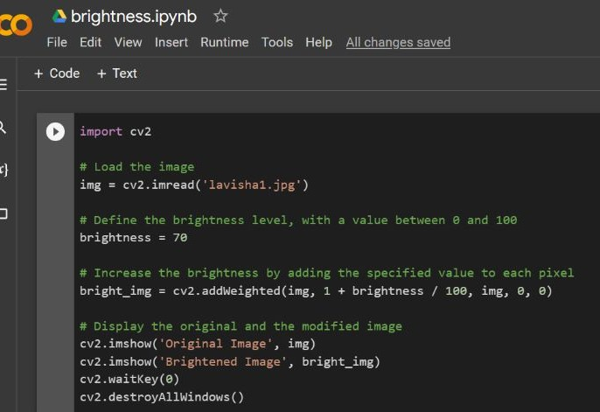
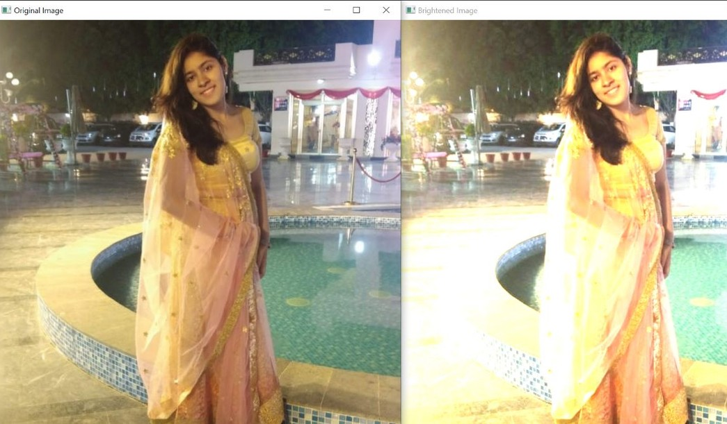
DEMONSTRATION
Name of the filter suggests that it controls the brightness of the image, in fact brightness filter is very similar to Photoshop’s brightness effect. filter: brightness([ <number> | <percentage> ]) As you can see number or percentage can be used as value for this filter with 100% or 1 being the default value.

Slide 13


ALGORITHM FOR DARKNESS
Import the OpenCV library.
Load the image named "varshitha.jpg" using the cv2.imread() function.
Define the darkness level as a variable named "darkness", with a value between 0 and
100. This value determines the amount of brightness reduction.
Use the cv2.addWeighted() function to decrease the brightness of each pixel in the image. This function takes the following arguments:
img: the input image.
alpha: weight of the first input image (in this case, it is 1).
beta: weight of the second input image (in this case, it is 0).
gamma: scalar added to each sum (in this case, it is -darkness). Store the darkened image in a variable named "dark_img".
Display both the original and the darkened image using the cv2.imshow() function.
Wait for a key press using the cv2.waitKey() function.
Destroy all windows using the cv2.destroyAllWindows() function.

Slide 14

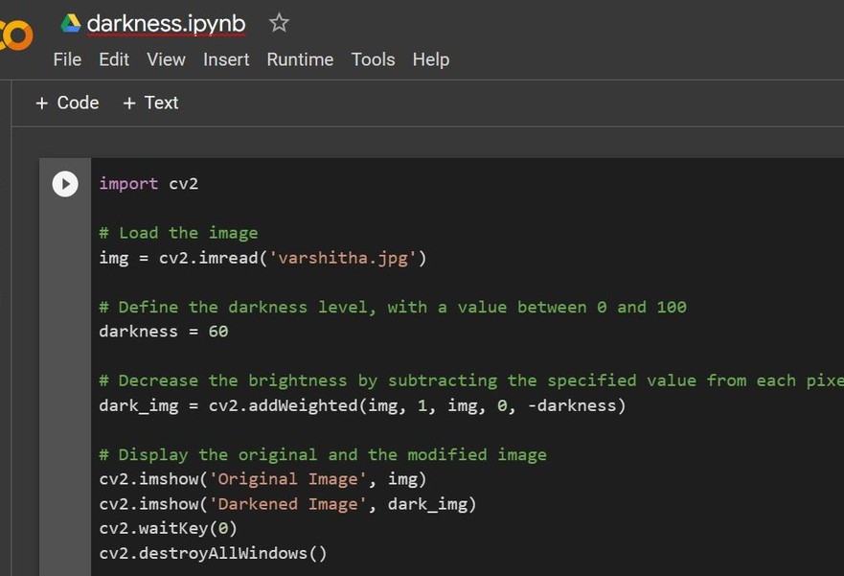
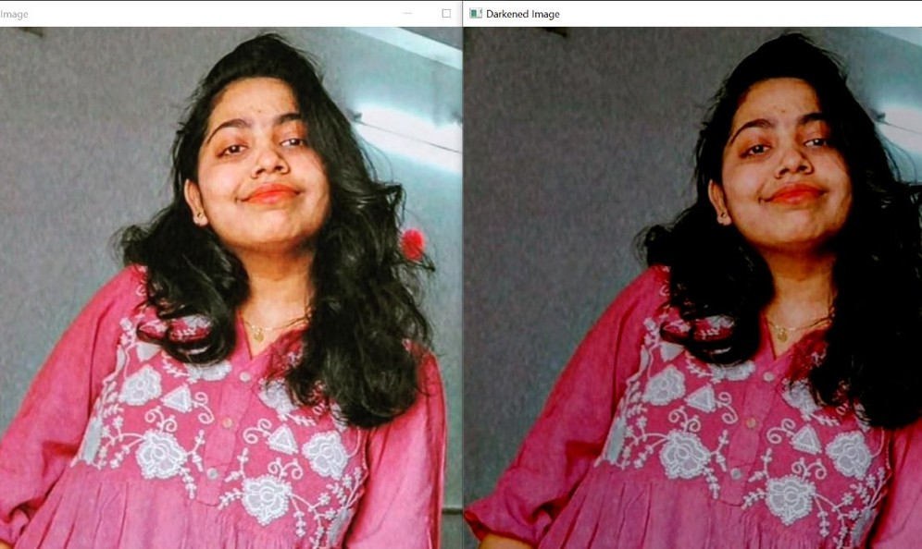
DEMONSTRATION
In image processing, adjusting darkness typically refers to modifying the overall brightness level of an image to make it darker.

Slide 15
ALGORITHM FOR CONTRAST
Import the OpenCV library using "import cv2" statement.
Load the image file using "cv2.imread()" method, and store the result in the "img" variable.
Apply contrast adjustment using "cv2.convertScaleAbs()" method with an "alpha" value of 1.5, and store the result in the "contrast_img" variable.
Display the original image and the contrasted image using "cv2.imshow()" method. Pass "Original" and "Contrasted" as window names, and "img" and "contrast_img" as images to be displayed, respectively.
Wait for a key press using "cv2.waitKey(0)" method. This will wait indefinitely until a key is pressed.
Destroy all open windows using "cv2.destroyAllWindows()" method.

Slide 16

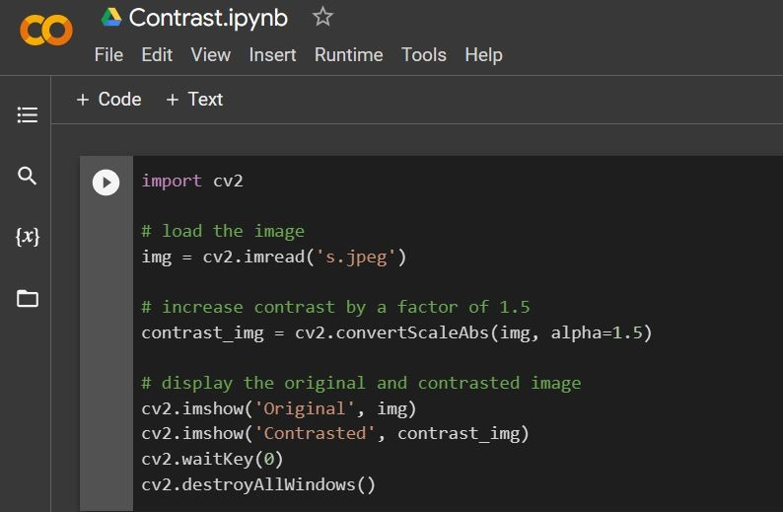
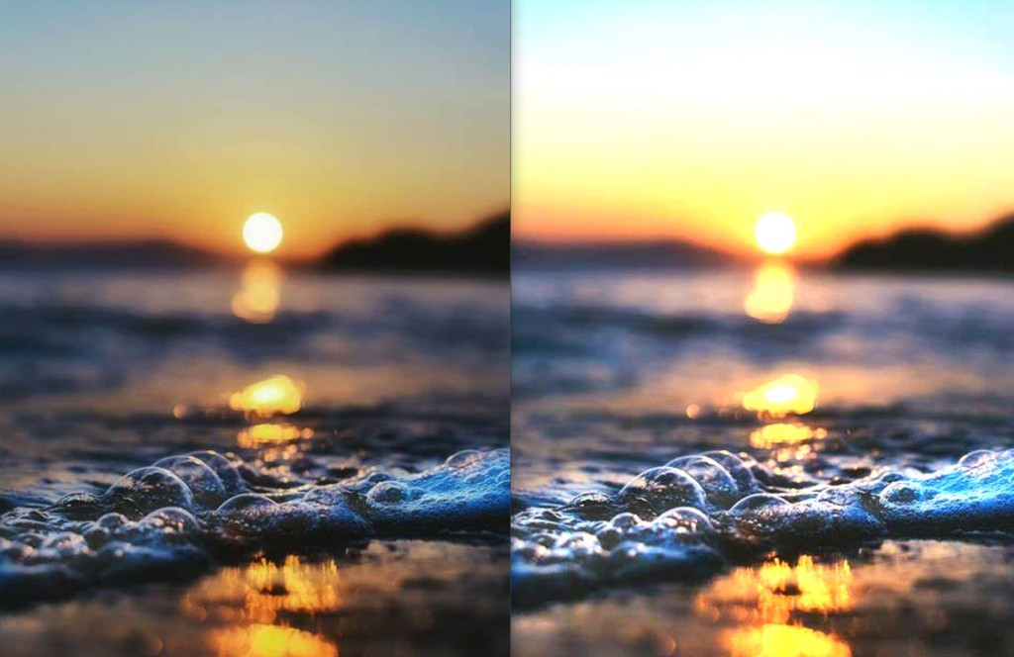
DEMONSTRATION
In image processing, contrast refers to the difference between the darkest and brightest parts of an image. The purpose of a contrast filter is to enhance or modify the difference between the dark and light areas of an image, thereby affecting the image's overall brightness and visual appearance.

Slide 17
ALGORITHM FOR FLIPPED IMAGE
Import the OpenCV library.
Load the image named "jaskiran.jpg" using the cv2.imread() function.
Flip the image by 180 degrees using the cv2.flip() function with the following arguments:
image: the input image.
flipCode: the code that determines the direction of flipping. A value of 0 flips the image vertically, a value of 1 flips it horizontally, and a value of -1 flips it both vertically and horizontally.
Store the flipped image in a variable named "flipped_image".
Display both the original and flipped images side by side using the cv2.imshow() function.
Wait for a key press using the cv2.waitKey() function.
Close all windows using the cv2.destroyAllWindows() function.

Slide 18

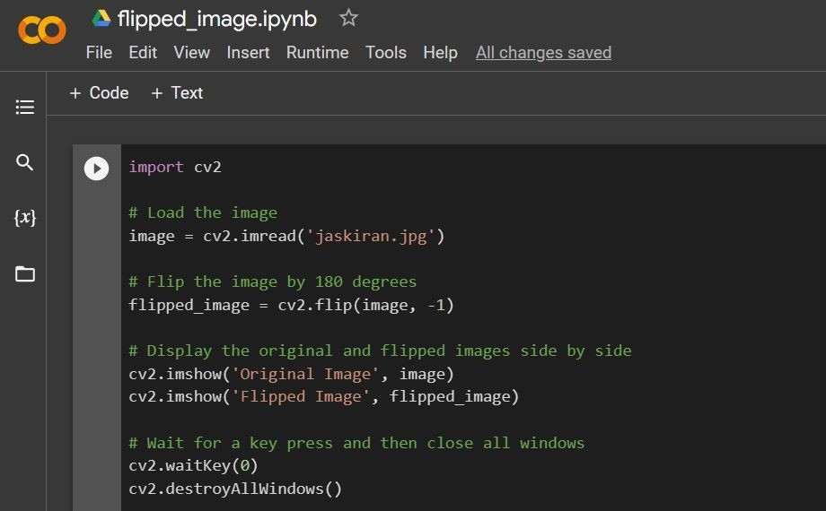
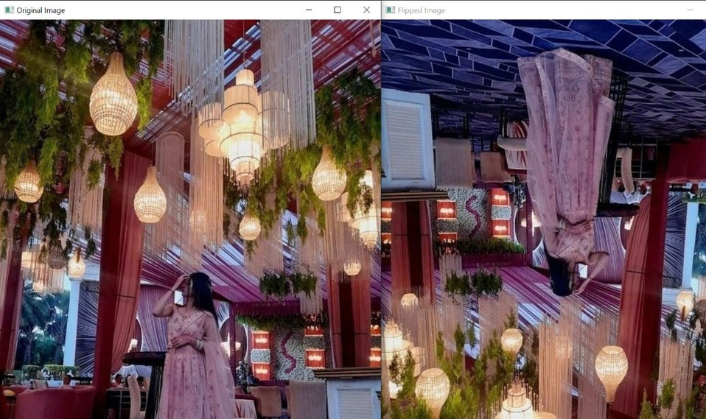
DEMONSTRATION
A flipped image in the context of artificial intelligence (AI) typically refers to an image that has been horizontally or vertically flipped using image processing techniques. Image flipping is a common image transformation operation that is used to create mirrored or flipped versions of an original image.

Slide 19

ALGORITHM FOR GHOST FILTER
Import the OpenCV library.
Load the image named "curl.jpeg" using the cv2.imread() function.
Invert the image using the cv2.bitwise_not() function, which computes the bitwise NOT operation on each pixel of the input image.
Store the inverted image in a variable named "inv_img".
Display both the original and inverted images side by side using the cv2.imshow() function.
Wait for user input using the cv2.waitKey() function.
Close all windows using the cv2.destroyAllWindows() function.

Slide 20
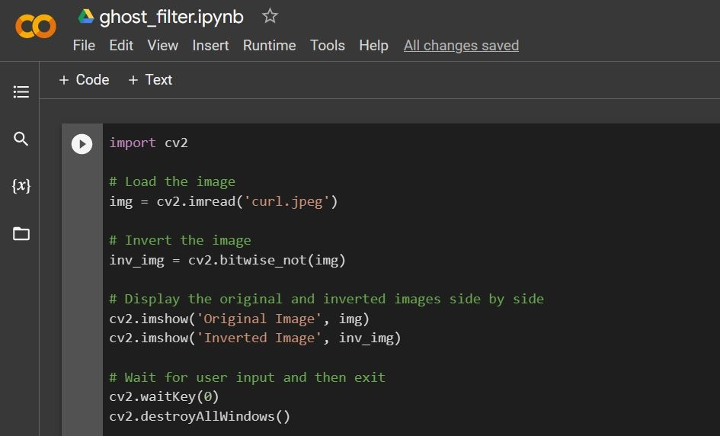
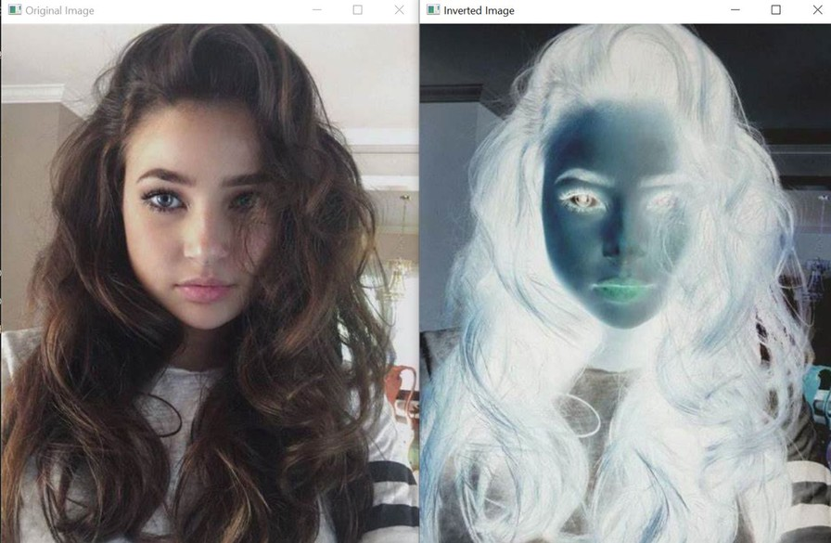
DEMONSTRATION
Ghost image is a form of print toning in photography, and refers to the warm colors that are produced by a specific chemical process in developing film. The toning process was popularized in the late 1800s for both logistical and artistic reasons. The chemicals involved in sepia toning better preserved photographs allowing them to last longer.
Artists also liked how different the warmer tones were compared to black and white photos.

Slide 21
ALGORITHM FOR CARTOON FILTER
Import the necessary libraries - cv2, numpy, and tkinter.filedialog.
Use the askopenfilename() function from tkinter.filedialog to prompt the user to select an image file and store the selected file's path in the variable photo.
Use cv2.imread() to read the image file stored in photo and store the image data in the variable img.
Convert the image to grayscale using cv2.cvtColor() and store the grayscale image in the variable grey.
Apply median blur with a kernel size of 5x5 to the grayscale image using cv2.medianBlur() and store the result in grey.
Use adaptive thresholding to obtain edges of the image using cv2.adaptiveThreshold(). Store the result in edges.
Use bilateral filtering to smooth the color image and reduce noise using cv2.bilateralFilter(). Store the result in color.
Create a cartoon-like effect by using cv2.bitwise_and() to bitwise AND the color image with itself using the edges mask as the operand.
Store the result in cartoon.Display the original image and the cartoon image side by side using cv2.imshow().
Save the cartoon image as a new file called "human.jpeg" using cv2.imwrite().Wait for the user to press a key using cv2.waitKey(0).
Close all windows using cv2.destroyAllWindows().

Slide 22
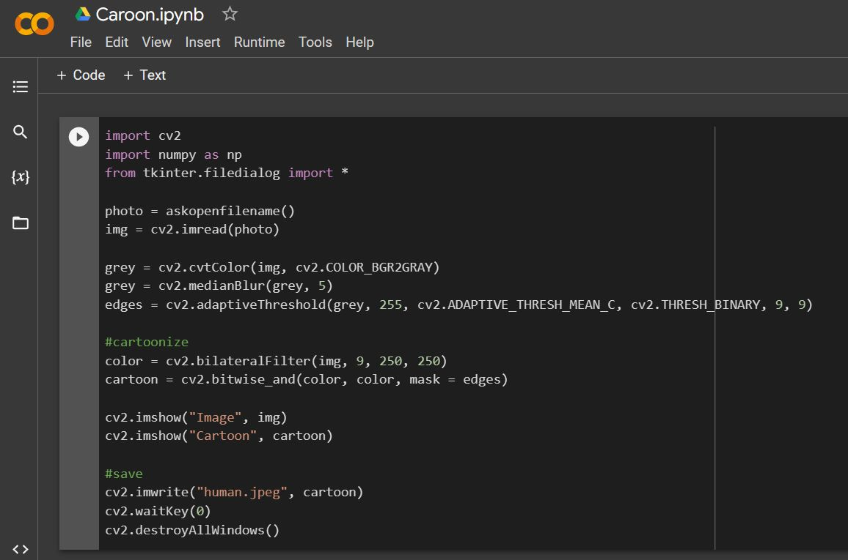
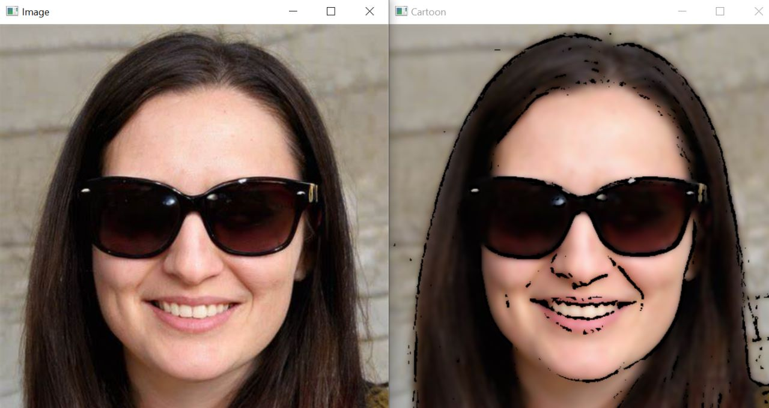
DEMONSTRATION
A cartoon filter is a digital image or video filter that is applied to a photo or video to give it the appearance of a cartoon or animated style . These filters are commonly used for creative expressions , artistic purposes and to add a touch of fun to visual content .

Slide 23

ALGORITHM FOR GENDER DETECTION
Import the necessary libraries:
deepface library for analyzing face attributes cv2 for reading and manipulating images matplotlib for displaying the image
Load the image using cv2.imread() function and store it in a variable img1 Display the image using plt.imshow() function and plt.show() function.
Analyze the gender of the image using the DeepFace.analyze() function with actions parameter as ['gender'] and store the result in a variable result.
Print the gender result using print() function.

Slide 24
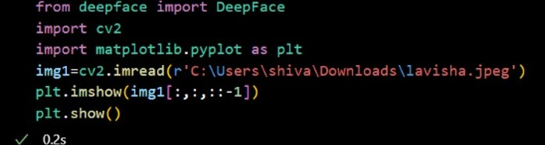
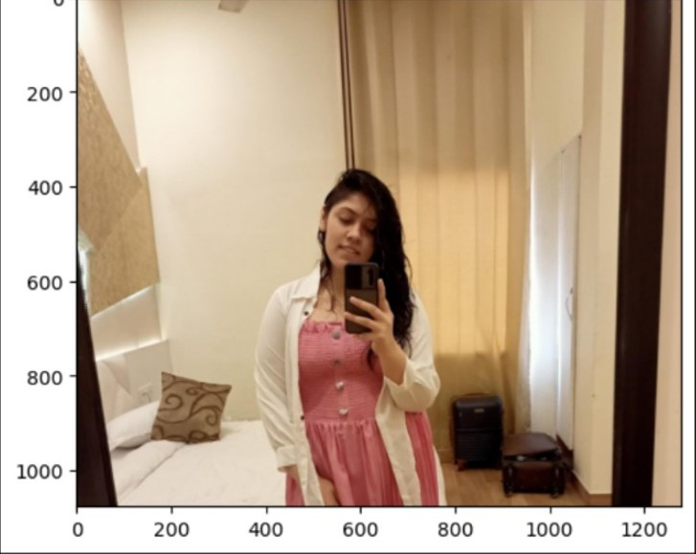
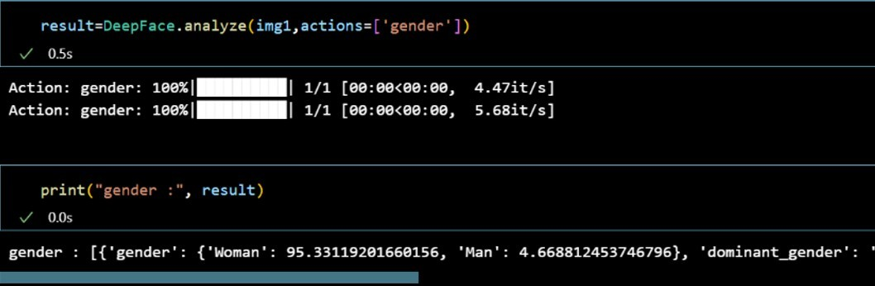
DEMONSTRATION : 1

Slide 25
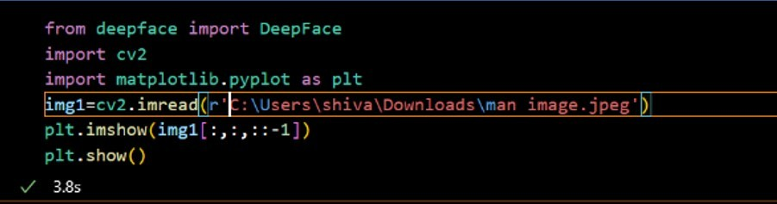
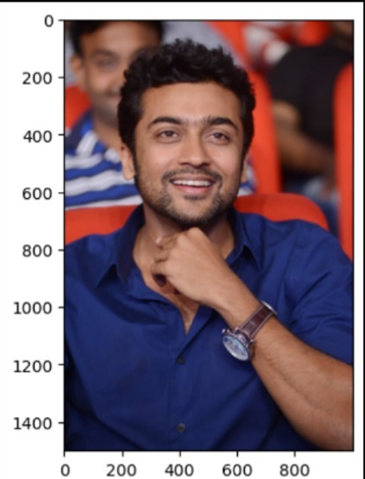
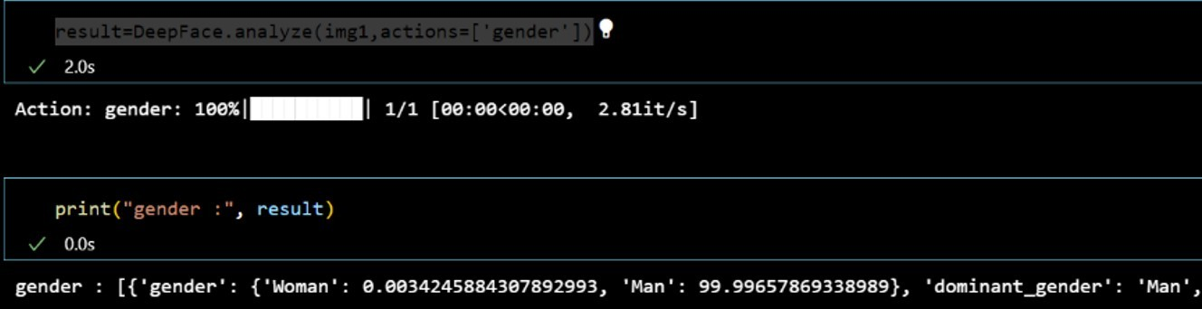
DEMONSTRATION : 2

Slide 26

ALGORITHM FOR EMOTION DETECTION
Import necessary libraries:
from deepface import DeepFace import cv2
import matplotlib.pyplot as plt
Load the image using cv2.imread() function:
img1=cv2.imread(r'')
Display the loaded image using matplotlib.pyplot.imshow() function: plt.imshow(img1[:,:,::-1])
Show the image using matplotlib.pyplot.show() function:
plt.show()
Analyze the loaded image using DeepFace.analyze() function with the emotion action specified:
result=DeepFace.analyze(img1,actions=['emotion']) Display the emotion result using print() function: print("emotion :", result)

Slide 27
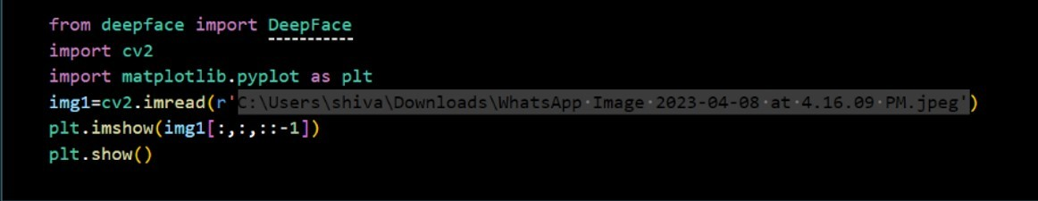
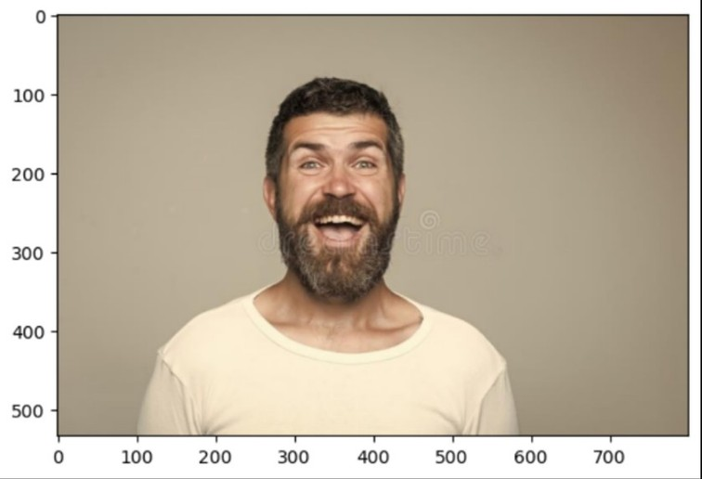
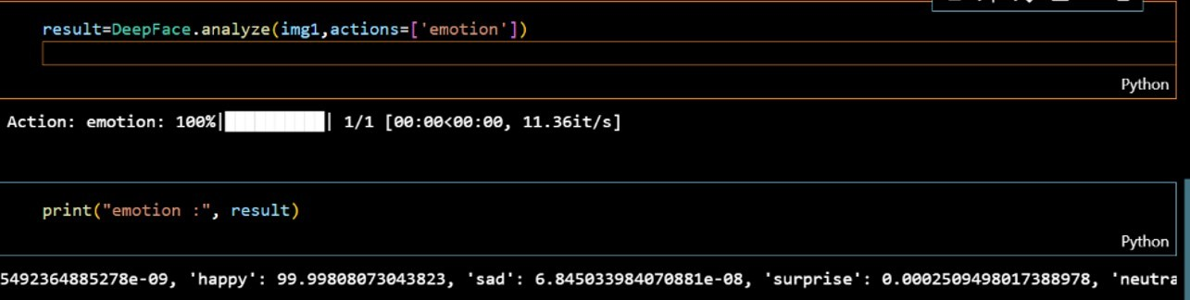
DEMONSTRATION : 1

Slide 28
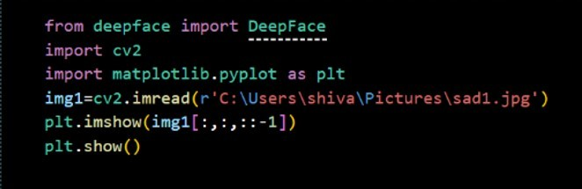
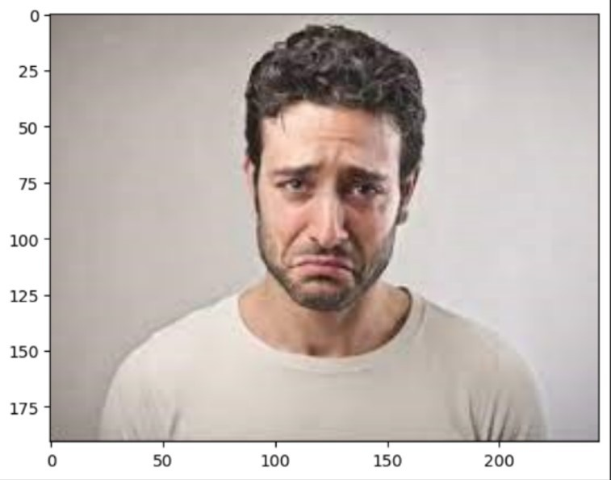
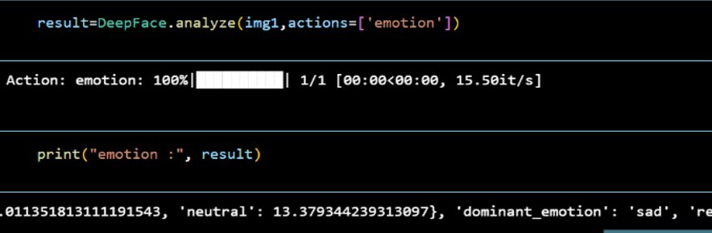
DEMONSTRATION : 2

Slide 29

ALGORITHM FOR AGE DETECTION
import deepface, cv2, matplotlib.pyplot
img1 = cv2.imread(r'C:\Users\shiva\Downloads\WhatsApp Image 2023-04-08 at
16.09 PM.jpeg')
plt.imshow(img1[:,:,::-1])
plt.show()
result = DeepFace.analyze(img1, actions=['age'])
print("age :", result)

Slide 30
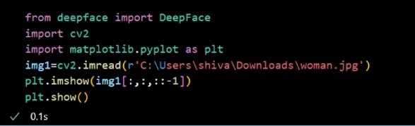
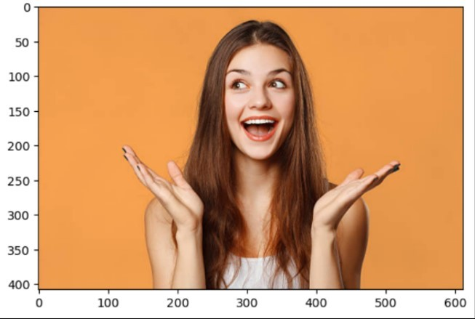
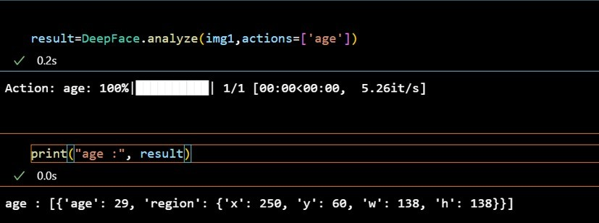
DEMONSTRATION : 1

Slide 31
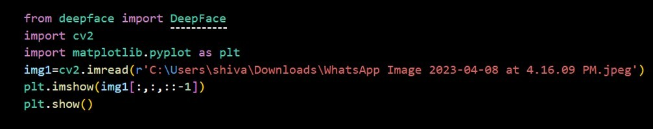

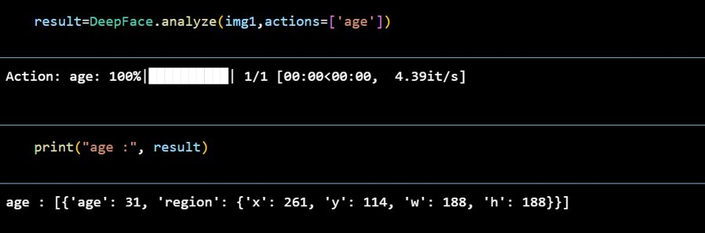
DEMONSTRATION : 2

Slide 32

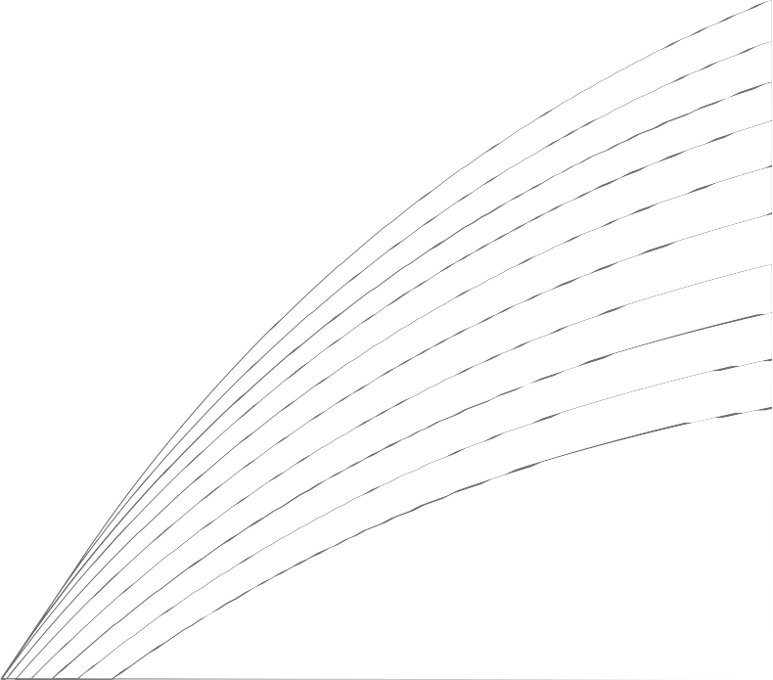
APPLICATIONS
01
02 03
04
IMAGE
ENHANCEMENT
This is commonly used in photography, video editing to improve the visibility of important features and details in images.
MEDICAL IMAGING
These techniques are crucial for analyzing
medical images such as X-rays, CT scans, and MRI scans for diagnosis
and treatment planning.
COMPUTER VISION
Computer vision
applications include
object recognition, face detection, image
recognition, and scene understanding, which are used in f ields such
as autonomous vehicles, surveillance systems,
and robotics.
IMAGE
RECOGNITION
This is used in
applications such as image-based search
engines, content-based image retrieval, and
image-based
recommendation systems.

Slide 33


APPLICATIONS
05
06 07
08
AUGMENTED REALITY (AR)
This is used in areas such as gaming,
entertainment, training, and simulation.
SECURITY
These techniques are used in applications such as video
surveillance, access control, and biometric
identification.
INDUSTRIAL AUTOMATION
These techniques are used in industries such
as automotive, electronics,
pharmaceuticals, and food processing to
ensure product quality and reduce
manufacturing defects.
SOCIAL MEDIA AND
ENTERTAINMENT
Used in applications for tasks such as image
editing, special effects, and image-based f i l ters and overlays for photos and videos on social
media platforms, photo- sharing apps.

Slide 34
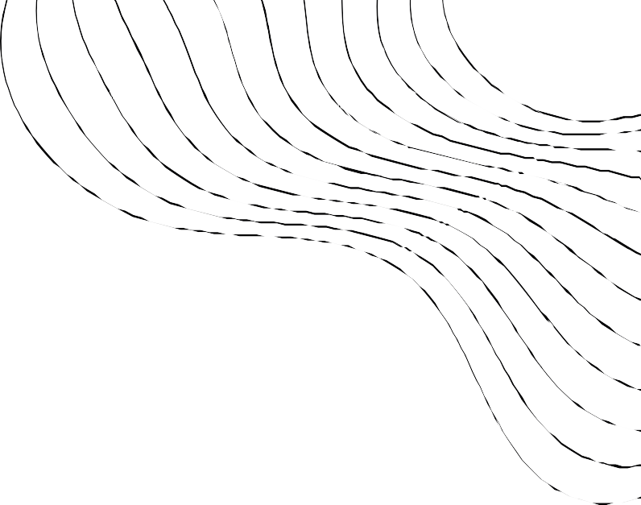
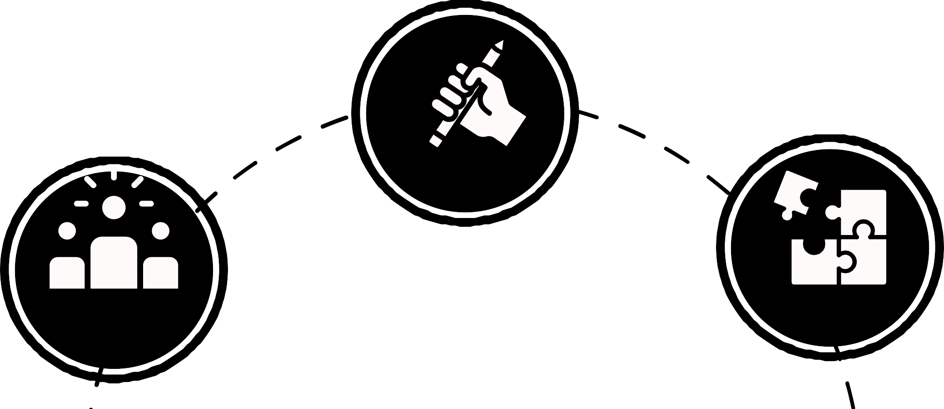
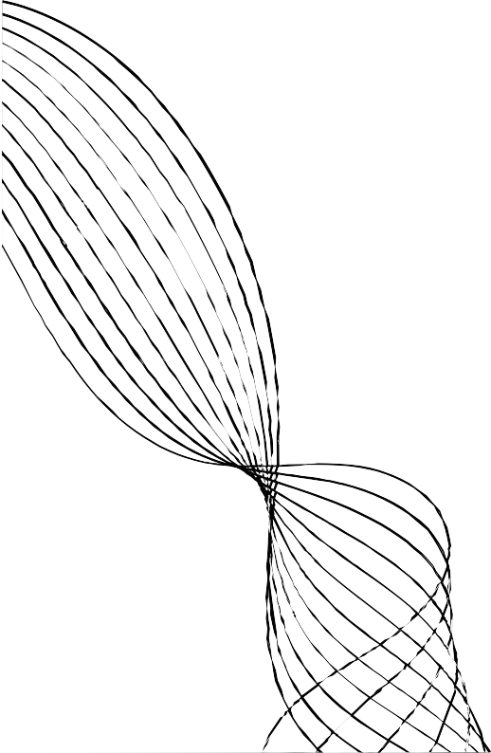
FUTURE SCOPE
Advanced Image Enhancement
Real-time Image Processing
Computational Photography
This includes techniques such as deep learning-
based image super- resolution, denoising, deblurring, and other
advanced image
enhancement algorithms
that can restore or enhance images with higher f idelity and accuracy.
Future developments may include more
efficient and optimized algorithms for real- t ime image processing, as well as hardware acceleration techniques to enable real-
t ime image processing on resource- constrained devices.
Future advancements in computational
photography may
include technologies such as l ight f ield
imaging, plenoptic
imaging, multi-camera systems, and other
novel imaging
techniques that can enable new types of
visual experiences and imaging capabilities.

Slide 35



FUTURE SCOPE
Image Forensics and Security
Image-based Human-Computer Interaction
Mobile and Edge Computing
reliable techniques for image forensics and
security, including deep
learning-based approaches for detecting sophisticated image manipulations and
developing encryption
techniques for secure image transmission and storage.
This includes
techniques such as cloud-assisted image processing, on-device image processing, and
distributed image processing to enable
more powerful and responsive image
processing capabilities on mobile and edge
devices.
Future developments include more
advanced algorithms for accurate and natural interaction, as well as integration
with other emerging technologies such as virtual reality, augmented reality

Slide 36
THANK YOU !

